Slide 1
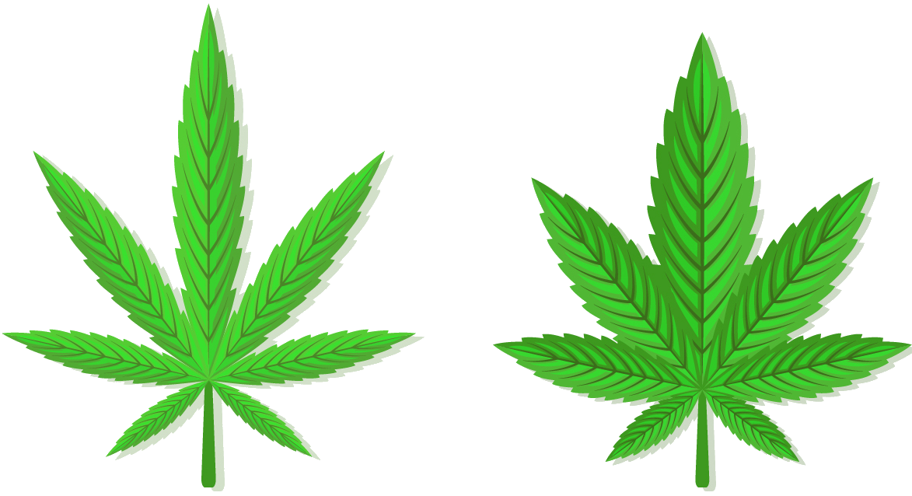
Sativa
Indica
Cannabis Analysis
Avitay Ingerman
Daniel Ofir
Hybrid
?

Slide 2

The Research
Background
Most of the cannabis strains that exist today are genetical descendants of 2 main strain types – Sativa & Indica.
As the popularity of cannabis increased in the last years thanks to countries legalizing the plant, the number of available strains increased accordingly.
New strains are created by hybridization of 2 existing strains.
Today, the 3 main types are: Sativa, Indica and Hybrid.
Our Goal
Create a Machine Learning model that can predict a strain’s type, based on a set of different features.

Slide 3
The Process
Data Acquisition
Data Scrubbing
EDA
(Data exploration)
Machine Learning Modeling
Scrape the web to get data about strains
Format, clean and complete missing data
Visualization of different aspects of the data
Create a ML model to predict the type of strain

